Slide 1
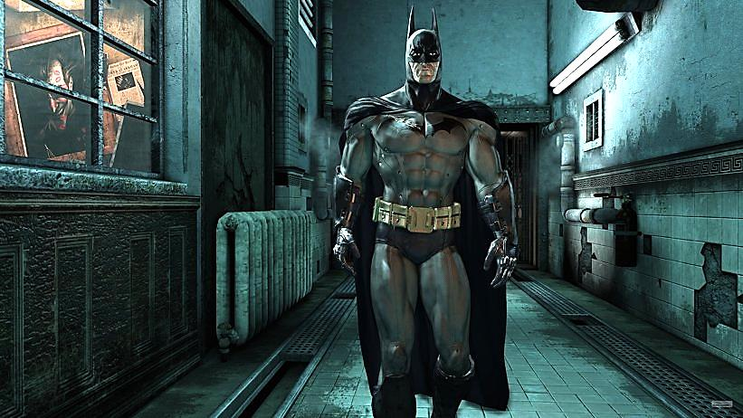
“I’m Batman”
Part One

Slide 2
Note: Any videos in this presentation will only play online. After you download the slideshow, you will need to also download the videos from YouTube & add them back into your PowerPoint.
We present these messages at Bee Creek Park in College Station, TX. If you would like to watch the video of the service with this message, click here:
We would love to know more about the people who download our lessons & sermons. We invite you to email us & let us know where & how you use them.
info@ckbrazos.org

Slide 3
Next Slide: Song – “Speak to Me” Download Here: http://youtu.be/wcUOa96Zu98

Slide 4
“I’m Batman”
Part One

Slide 5
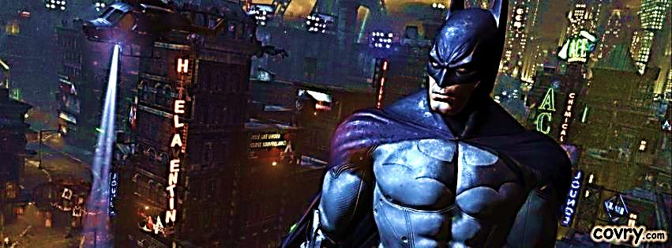
I’m Batman (pt. 1)
This cartoon character is based on a man who has acquired some bat attributes (and gadgets).
He is not real, but in the spiritual realm, believers are indeed equipped with special gifts that make them operate differently than average humans. Some of these abilities can be compared to bat traits.

Slide 6
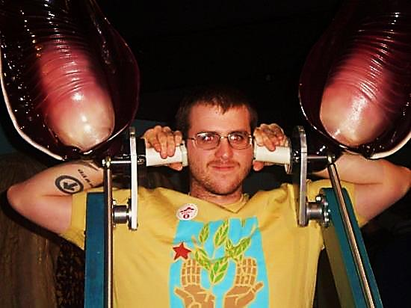
Hearing is the bat’s most important sense.
Simulated Bat Ears at The Bat Jungle
Costa Rica

Slide 7
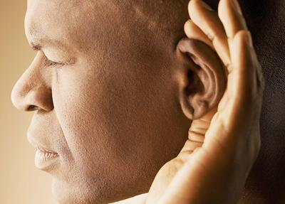
God gives us a special ability to hear Him – Our “Bat-Ears”
Seeing Jesus can give us comfort,
but hearing Jesus always gives us faith.
“So then, faith cometh by hearing, and hearing by the word of God.” Romans 10:17

Slide 8
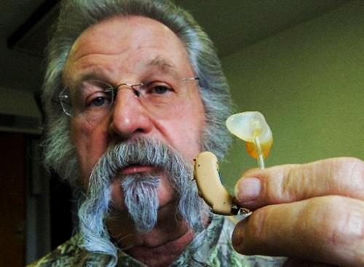
A man bragged that he had the finest hearing aid in the world. A friend asked, “Really, What kind is it?" He replied, “Oh, About 2:30.” Ha, Ha.

Slide 9
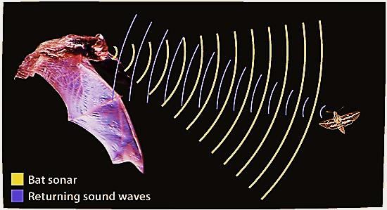
Bats “See” With Their Ears
Bats have tiny eyes and large ears. God has given them another way to “see” — by using their ears — this is called echolocation.
Bats make sounds that humans cannot hear. The sound waves strike an object, then →

Slide 10
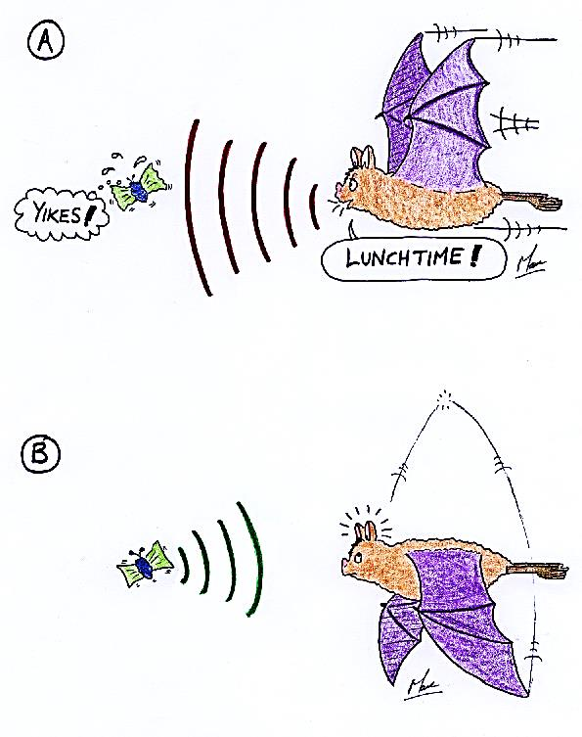
Then, a fraction of a second later, an echo returns to the bat’s eardrums.
The bat hears the echo and is able to tell how far away the object is — and in what direction.

Slide 11
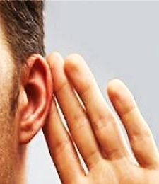
How to Get Heavenly Bat Ears
When we hear God’s Word (with an open heart) God develops our “spiritual ears.”
The bible calls this “ears to hear” or “hearing.”
These special ears produce faith in us.
“…faith comes by hearing, and hearing by the word of God.” Romans 10:17

Slide 12
Hearing God’s Word Imparts
Faith in the Believer

Slide 13
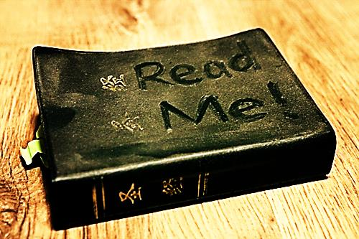
With God’s “Ears to Hear” We “See”
We enter God’s “Bat Cave” (the Bible) as blind men.
We arise with faith (or sight).
A little girl said, "I know everything that's in the Bible. Let's see - there's a lock of hair, some dried flowers,…“ Ha, Ha

Slide 14
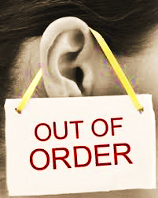
Deafness is a condition where either the sound is not getting to the brain or it is getting there and the brain is unable to perceive it.
Likewise we may not be hearing the Word, or we hear it but we don’t perceive it.

Slide 15
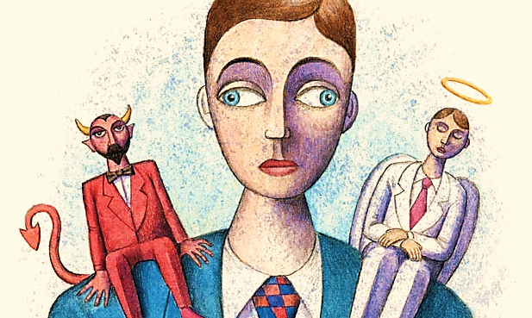
“And your ears shall hear a word behind you, saying, this is the way, walk in it, when you turn to the right or when you turn to the left.” Isaiah 30:21

Slide 16
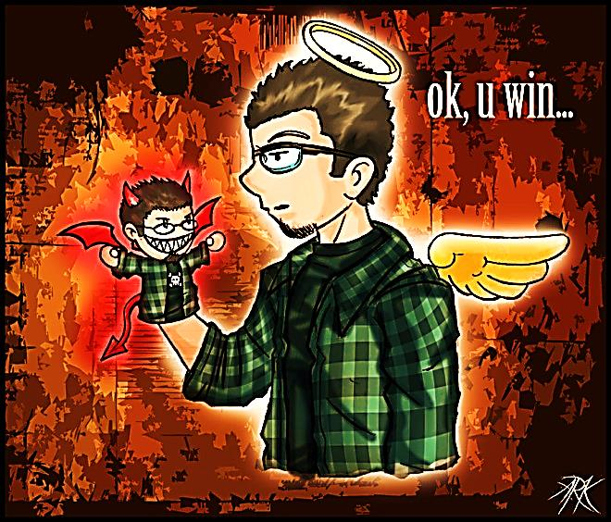
But, hearing can be damaged.
These evil people cannot see what is right and what is wrong. It is like their conscience has been destroyed with a hot iron. 1 Timothy 4:2
When your Conscience is dead, you barely even hear the good voice anymore.

Slide 17
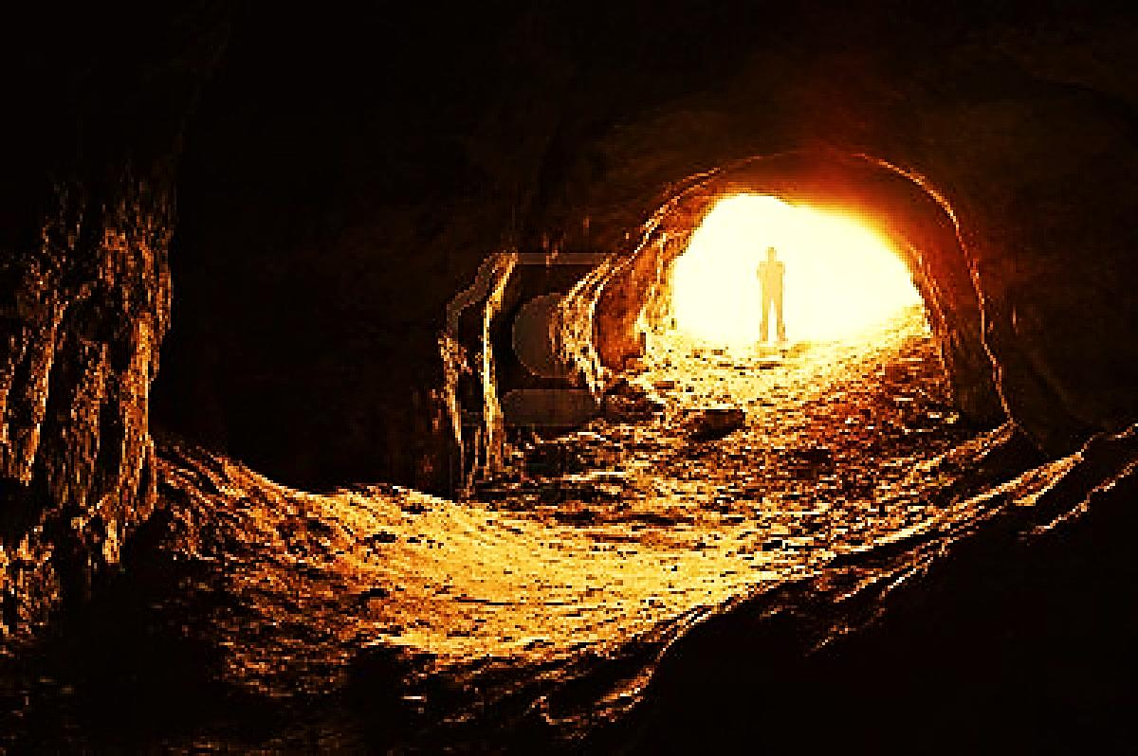
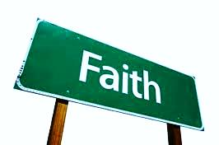
We Need Cave Time
First, we need to hear the Word (get some cave time) and then it can begin to heal our broken consciences and revive our dead faith.
“The word is near thee, even in your mouth, and in your heart. This is the word of faith…”
Romans 10:8

Slide 18
"I can find ten men who will die for the Bible for every one who will read it” Spurgeon

Slide 19
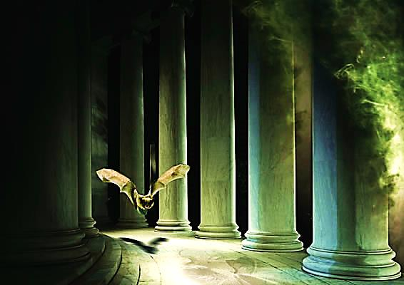
Scientists have learned that even though their eyesight is extremely poor, by using echolocation, bats can soar freely through difficult spaces.
“For we walk by faith, not by sight.” 2 Cor. 5:7

Slide 20
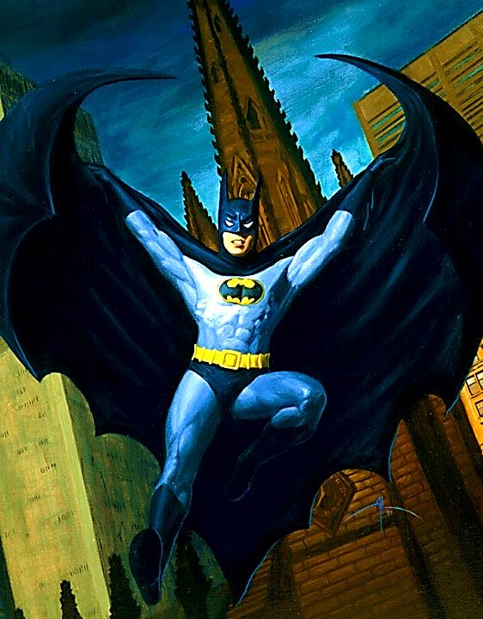
God’s “batman” soars fearlessly on his missions, believing what he has heard from God!
“…what you hear whispered in the ear, proclaim upon the housetops.”
Mat.10:27

Slide 21
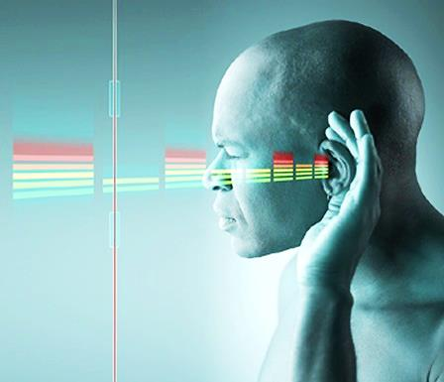
Like the bat, the believer hears the echoes -- God’s Word bouncing back into his “ears to hear.” It says things like, “do this,” “say this,” “go forward,” & “don’t be afraid.”
We soar through the unknown maze of our mission without fear – God’s voice echoing in our ear, giving His directions.

Slide 22
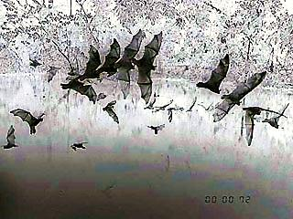
Sight is how the unbeliever (blindly) navigates. Hearing is how the believer fearlessly soars.
"God, who made the birds never made bird cages. It's men who make bird cages and after a while we become cramped and can do nothing but chirp and stand on one leg."
Oswald Chambers

Slide 23
In order to truly soar, we must spend time in the “bat cave.”
Things may look impossible but then, the voice in our Heavenly bat-ears says, “go on, God is with you.”
Spend time in prayerful bible study, and come out ready to soar for God!

Slide 24
Next Slide: Song – “Speak to Me” Download Here: http://youtu.be/wcUOa96Zu98

Slide 25
Is Jesus Speaking to You?
“They said to each other, ‘Did not our hearts burn within us while he talked to us on the road, while he opened to us the Scriptures?’”
John Wesley Said:
“…the preacher was describing the change which God works in the heart through faith in Christ and I felt my heart strangely warmed.”
Jesus makes His presence Known by a small voice!

Slide 27
What is the Sinner‘s Prayer?
This is a prayer we can pray when we are ready to admit we are sinners and need Christ’s forgiveness.
It must be prayed with faith in our hearts and a readiness to have a life-changing encounter with Jesus Christ.

Slide 28
A prayer of faith → Pray this prayer if :
If you never have before
You have in the past, but you think it would mean more today
You have been walking afar off and you want to come back
You want to set an example & show others how it is done
You just like to give your heart to Jesus again & again
Faith

Slide 29
We Declare Our Faith Publicly Because Jesus Declared His LOVE Publicly
“If you stand before others and are willing to say you believe in me, then I will tell my Father in heaven that you belong to me.” Mat 10:32

Slide 30
Important Questions
Do you want to know Jesus as your Savior right now?
Do you believe He died to save you from your sins & that He rose from the dead?
Do you believe that He is here, waiting to save you right now?

Slide 31
The Prayer of a Sinner Turning to Jesus
Dear Jesus, I know that I have sinned against You and that my sins separate me from You.
I am truly sorry.
Right now, I turn away from my sinful past .
Please forgive me, and help me to keep from sin.
I believe You died for my sins.
I Believe You rose from the dead, you are alive, and you hear this prayer from my heart.
I invite You Jesus to be both my Savior and the Lord of my life.
I want You to rule my life from now on.

Slide 32
“But some people did accept him. They believed in him, and he gave them the right to become children of God.”
John 1:12

Slide 34
“If you openly say, ‘Jesus is Lord’ and believe in your heart that God raised him from death, you will be saved.”
Rom. 10:9
What did you learn today?
What is the meaning of the name-tag?
What have you been thinking about God lately?
What do you want to tell the world about Jesus?

Slide 35
“Draw near to God, and He will draw near to you…
Altar Time
…Cleanse your hands, you sinners, and make your hearts pure, you who are half-hearted towards God.” James 4:8 WNT

Slide 36
Close in Prayer

Slide 37
Note: Any videos in this presentation will only play online. After you download the slideshow, you will need to also download the videos from YouTube & add them back into your PowerPoint.
We present these messages at Bee Creek Park in College Station, TX. If you would like to watch the video of the service with this message, click here:
http://campaignkerusso.org/?p=11026
We would love to know more about the people who download our lessons & sermons. We invite you to email us & let us know where & how you use them.
info@ckbrazos.org

Slide 38
Welcome to Aggieland Faith Family Style Worship

Slide 39
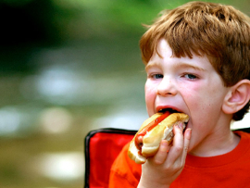
CURRENT SCHEDULE: See www.Aggielandfaith.org
SUNDAY —
At Bee Creek Park
2:00-4pm: Free snacks, drinks, kids crafts, prizes, singing & bible preaching

Slide 40
Would You Like Prayer or Bible Study at Your House?
Personal Prayer: We can come to your home & pray with you, or you can email us when you need prayer.
Home Bible Study: We will come to your home & hold a bible study for you & your friends.
Bible Party: We will hold a Kid’s Bible Party: You provide the food & kids - we will do the bible fun & stories.

Slide 41
Would You Like Visitation?
We will visit a friend, loved one in the hospital or in prison to pray for them & share Christ with them.
Contact: info@aggielandfaith.org

Slide 42
www.aggielandfaith.org
Go here to see pictures & videos
Go here to subscribe to e-mails about changes & cancellations

Slide 43
Note: Any videos in this presentation will only play online. After you download the slideshow, you will need to also download the videos from YouTube & add them back into your PowerPoint.
We present these messages at Bee Creek Park in College Station, TX. If you would like to watch the video of the service with this message, click here:
http://campaignkerusso.org/?p=11026
We would love to know more about the people who download our lessons & sermons. We invite you to email us & let us know where & how you use them.
info@ckbrazos.org

